Slide 1
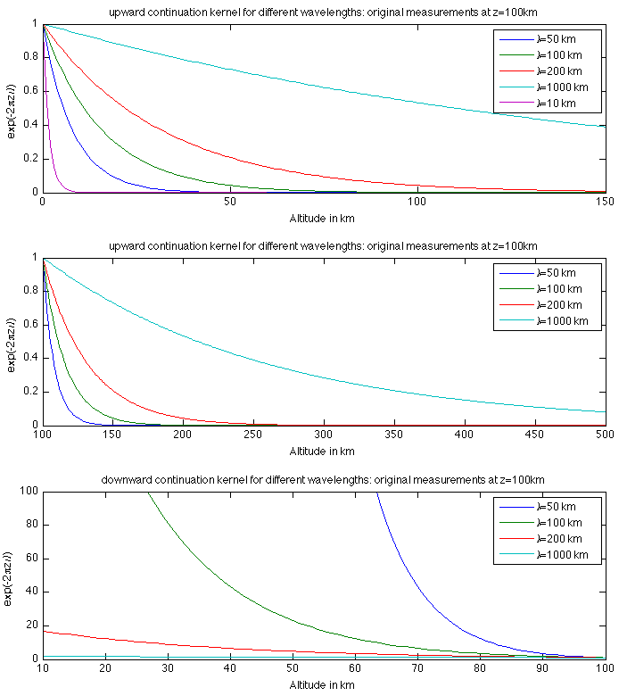
from last time: upward/downward continuation

Slide 2
Geophysicists’ Toolkit: Spherical Harmonics - 1
One way to represent a global data set on a sphere is to use spherical harmonics. These are similar in concept to Fourier Series.
Remember that a function f(t) that is periodic over an interval T can be synthesized from a sum of sinusoids with integer wavenumber m.:
the sine and cosine functions are orthogonal
this property allows us to obtain the coefficients a_{m} and b_{m}, provided we know f(t)

Slide 3
Geophysicists’ Toolkit - 2
Imagine wrapping the periodic function f(t) around a circle of longitude:
equate t with longitude (φ)
set T = 2 π
Now consider such series at all latitudes, so
How should we represent the latitude (strictly co-latitude) functions?

Slide 4
Geophysicists’ Toolkit - 3
How should we represent the co-latitude (θ) functions a_{m}(θ) and b_{m}(θ) ?
Typically use Associated Legendre Functions, denoted by P_{l}^{m}(cosθ):
Notice that at each l there are 2l+1 possible choices of m.
FAQ:
Why the l and m?
What do the P_{l}^{m} functions look like?
What are the g_{l}^{m}, h_{l}^{m}?
You’ve lost me already – what’s the point?

Slide 5
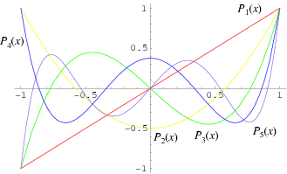
Geophysicists’ Toolkit - 4
Why the l and m? Imagine something that is constant at all longitudes i.e., m = 0. That property can still vary in any way with latitude, so can be described a sum of a series of functions each with different l.
l, m are called the spherical harmonic degree and order respectively
What do the P_{l}^{m}(cosθ) look like?
P₁₁⁰
m=0 :Legendre Polynomials

Slide 6
Geophysicists’ Toolkit - 5
The combined φ and θ terms, P_{l}^{m}(cosθ) cos(mφ) or P_{l}^{m}(cosθ) sin(mφ) are often referred to as a spherical harmonic of degree, l and order, m:
l=11, m=0
l=6, m=6
l=8, m=4
For a function that varies only with latitude: need only m=0 terms
For a function that varies only with longitude: need only m=l terms
Higher l,m terms correspond to higher spatial frequency, shorter wavelength
- (l-m)=even, then symmetric about equatorial plane
(l-m)=odd, then antisymmetric about equatorial plane
vanish on (l-m) lines of latitude and 2m lines of longitude
Notes:
Vanish on (l-m) lines of latitude and 2m lines of longitude

Slide 7
Geophysicists’ Toolkit - 6
What are the g_{l}^{m}, h_{l}^{m}?
Coefficients: tell us how much of each spherical harmonic is present. Analogy in cartesian coordinates is Fourier coefficients.
l=11, m=0
l=6, m=6
l=8, m=4
What’s the point?
Can describe any function on a sphere as a series expansion. The functions in the expansion are spherical harmonics, the coefficients are the g_{l}^{m}, h_{l}^{m}
Notes:
Radial gravity anomaly (mGal)

Slide 8
Geophysicists’ Toolkit - 7
What are the g_{l}^{m}, h_{l}^{m}?
Coefficients: tell us how much of each spherical harmonic is present. Analogy in cartesian coordinates is Fourier coefficients.
What’s the point?
Can describe any function on a sphere as a series expansion.
The functions in the expansion are spherical harmonics, the coefficients are the g_{l}^{m}, h_{l}^{m} and the sum is over all possible wavelengths in longitude and co-latitude.
Codes are available to evaluate a function f(θ,φ) given coefficients
Equivalent tools to those in Fourier analysis apply: e.g. we can look something called a spherical harmonic power spectrum

Slide 9
Geophysicists’ Toolkit - 8
Upward / Downward Continuation
We can use spherical harmonics to describe ANY function (topography, seismic velocity, …) on a spherical surface since the SHs are orthogonal functions
However, in potential fields they are even more useful because they are the (θ, φ) solutions to Laplace’s equation in spherical coordinates. The radial (r) solution gives us a way to upward/downward continue the field. The full solution to Laplace’s eqn for internal sources (sources at r ≤ R_{a}, where R_{a} is the planetary surface) is:

Slide 10
Geophysicists’ Toolkit - 9
See the pdf notes for the full solution for internal and external sources
Relationship between SH degree, l, and wavelength, λ, at a given radius, R:
As with the solution in cartesian coordinates, higher spherical harmonic degrees (i.e., shorter wavelengths) decrease more rapidly with increasing radius
upward continuation kernel in spherical coordinates

Slide 11
Upward / Downward Continuation
Example: Mars’ Magnetic Field
Measurements of Mars’ magnetic field made by s/c in orbit 400 km above surface of planet. A few measurements were made over the southern hemisphere at altitudes of ~200km.
We can make a spherical harmonic model of the field. What happens when we evaluate the field at different altitudes: 1000km, 400km, 200km, 100km?

Slide 12
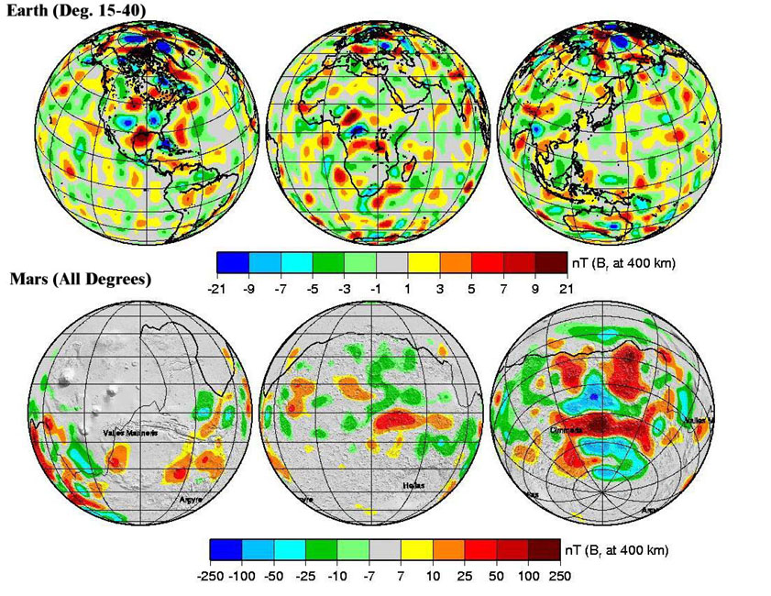
Lithospheric Magnetic Fields - Earth and Mars

Slide 13
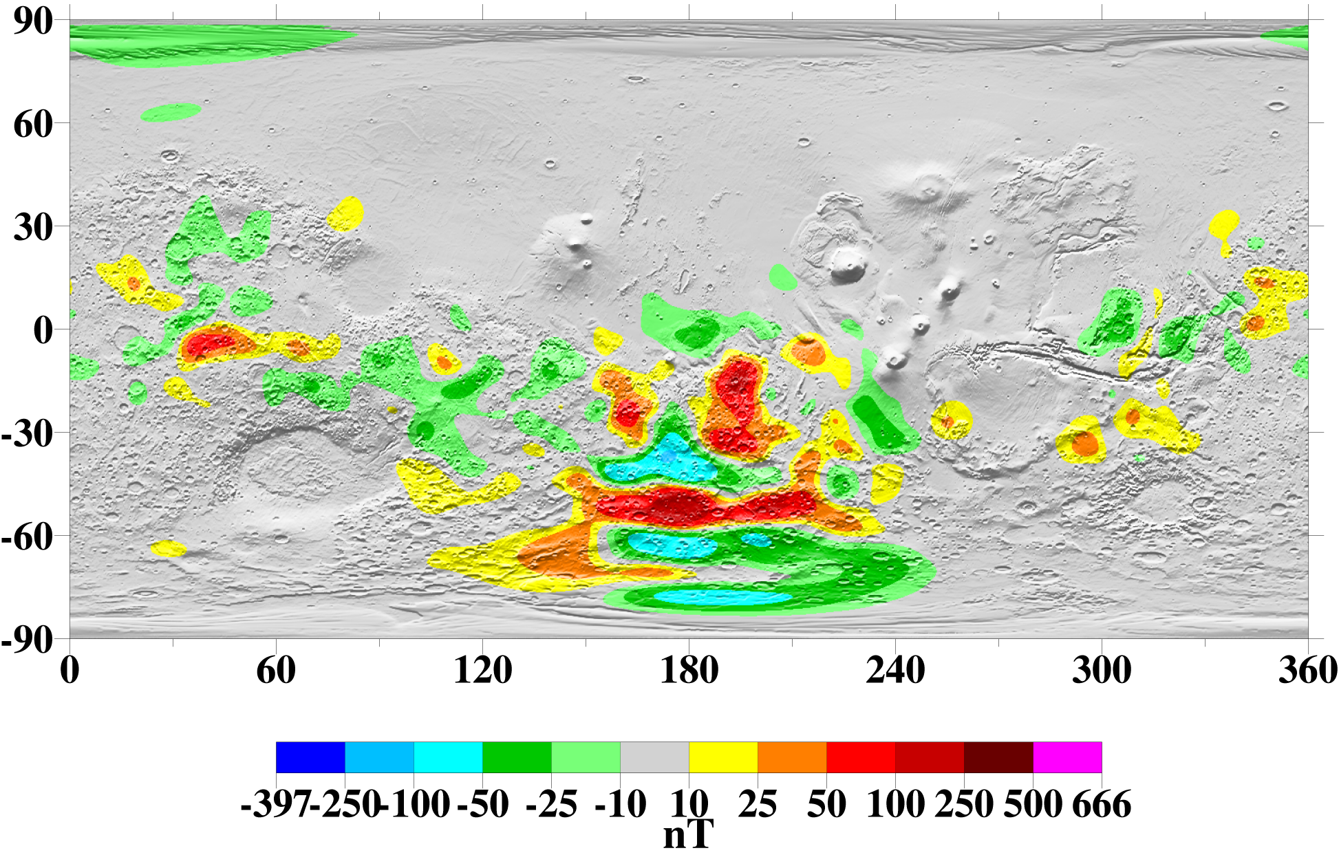
Br (nT) at 400 km altitude

Slide 14
Br (nT) at 400 km altitude

Slide 15
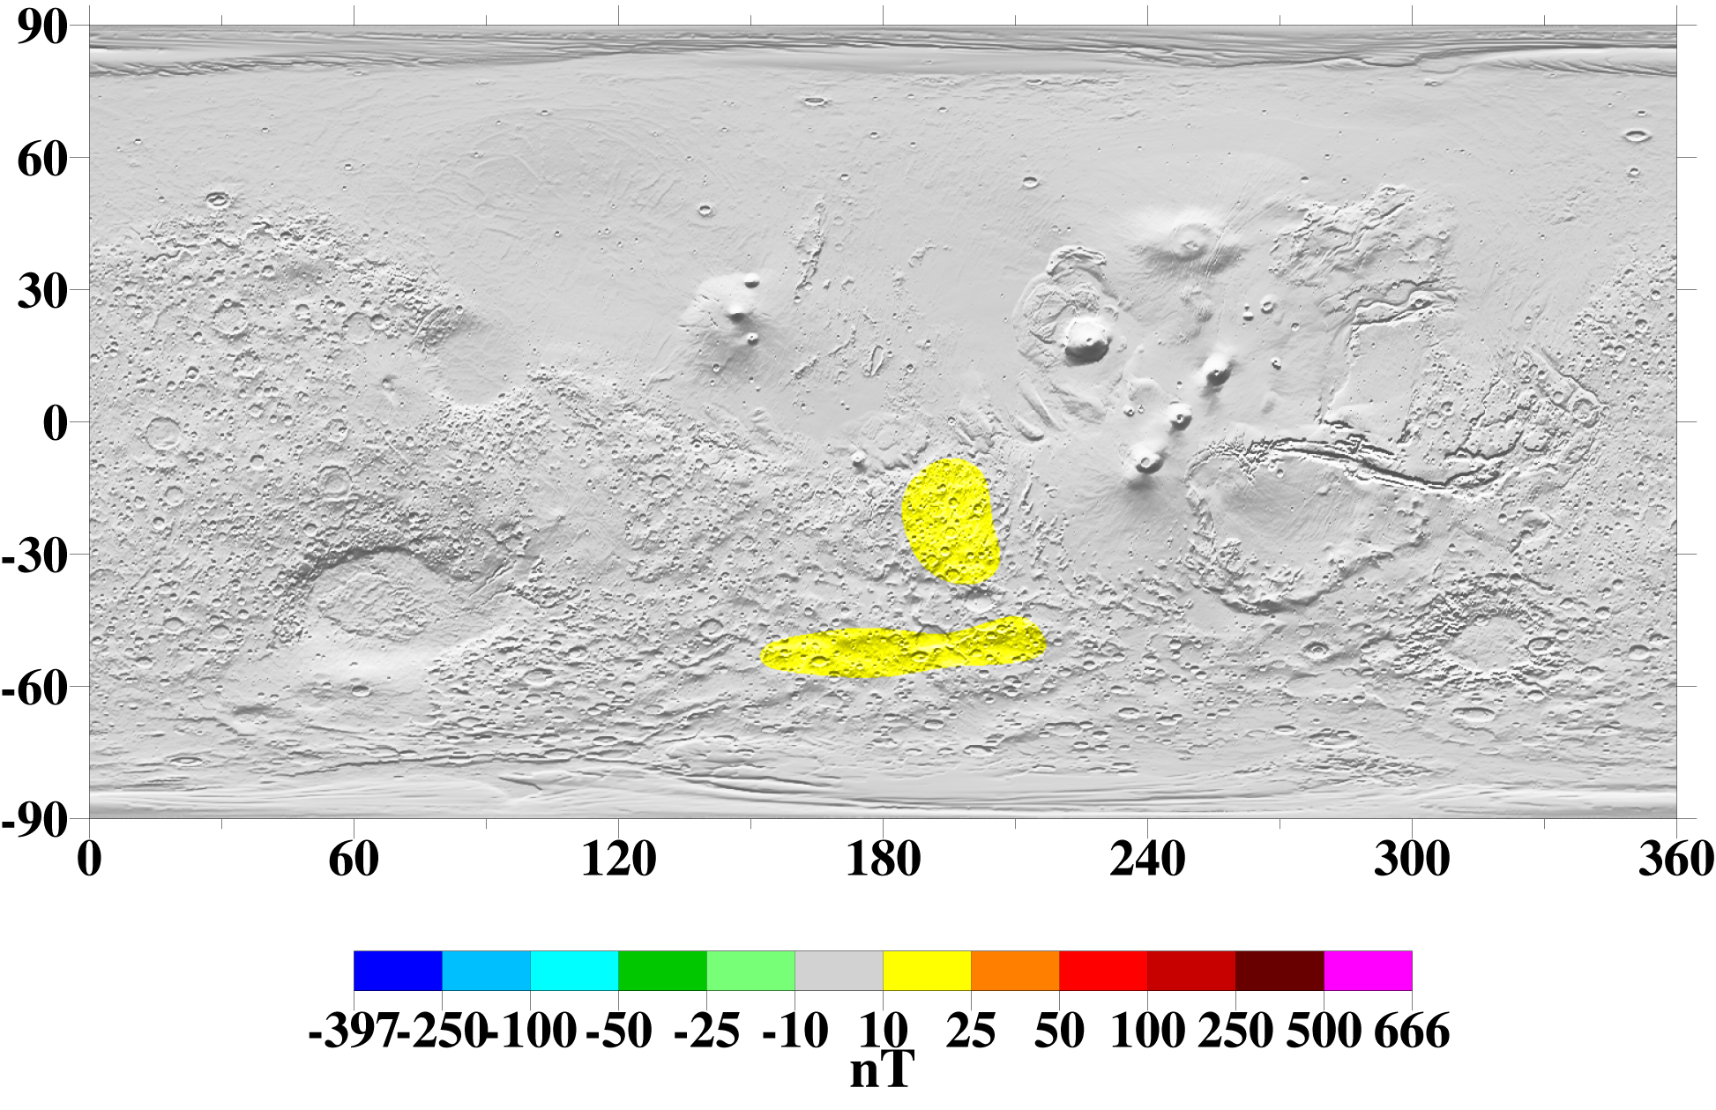
Br (nT) at 1000 km altitude

Slide 16
Br (nT) at 400 km altitude

Slide 17
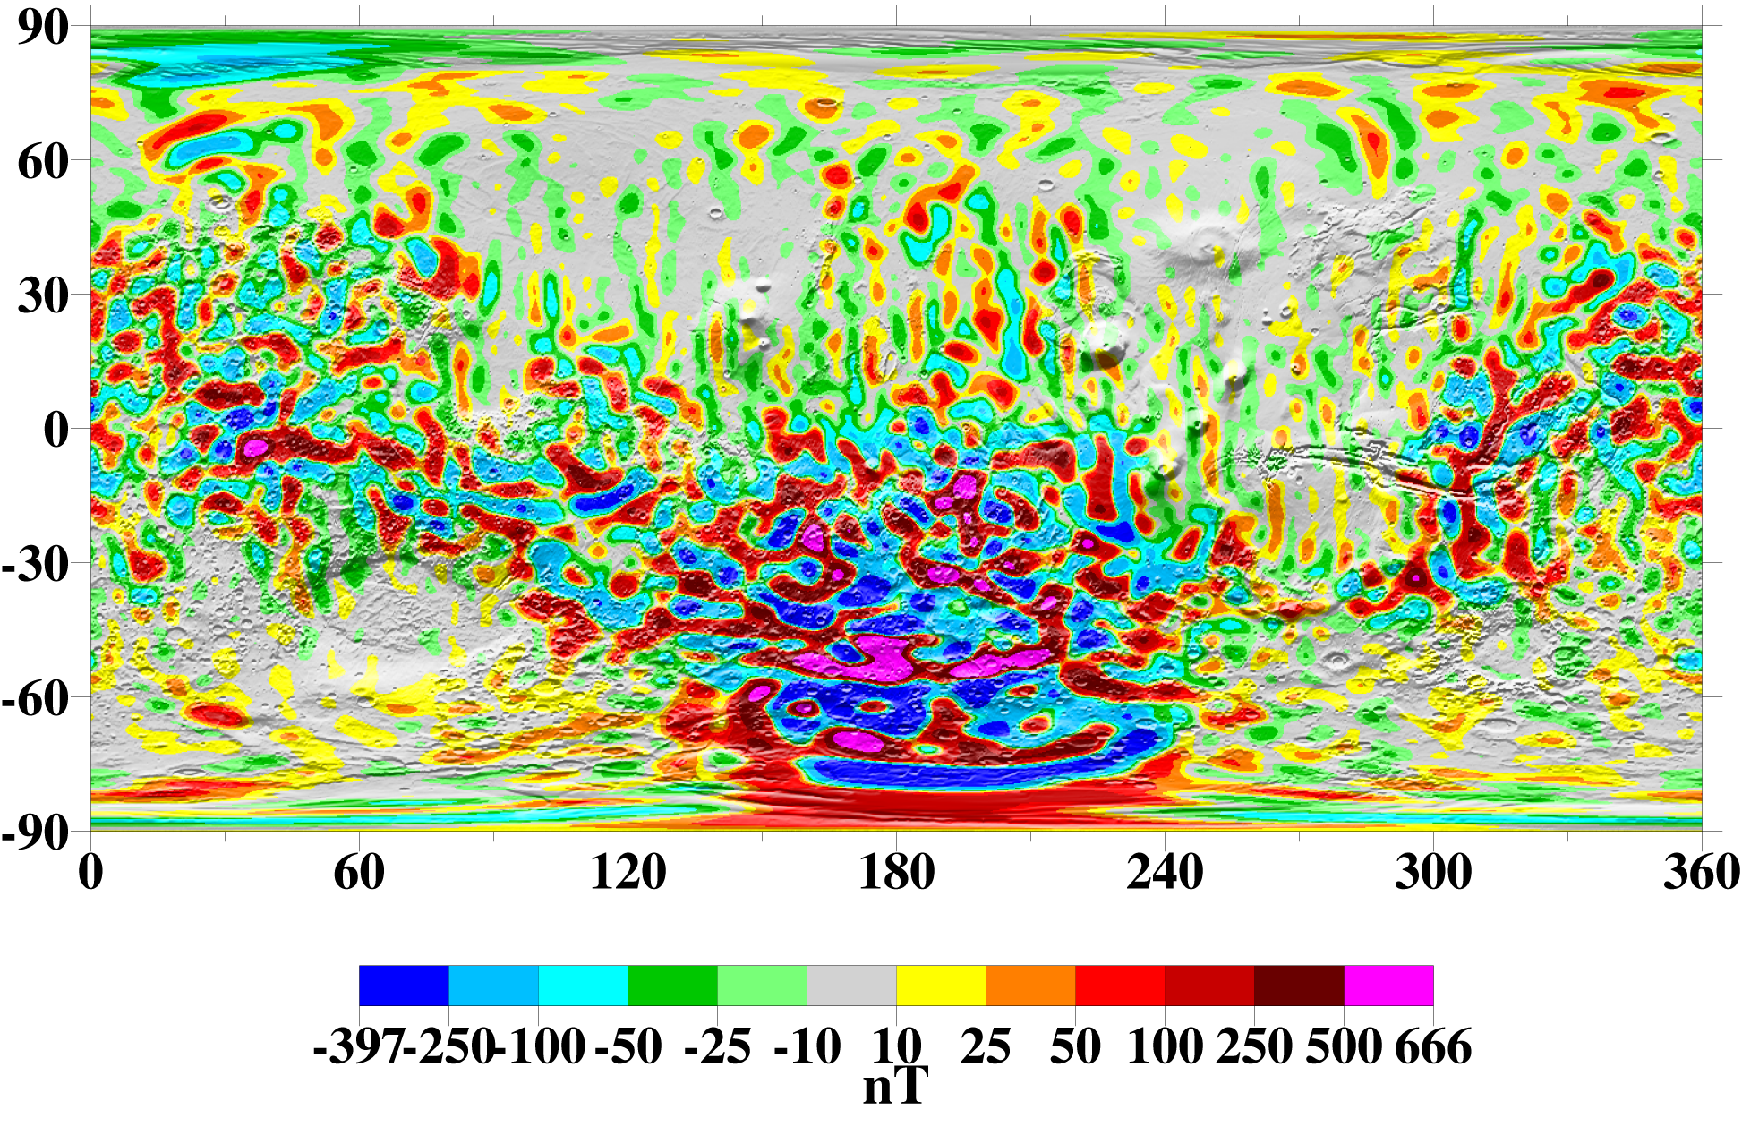
Br (nT) at 100 km altitude

Slide 18
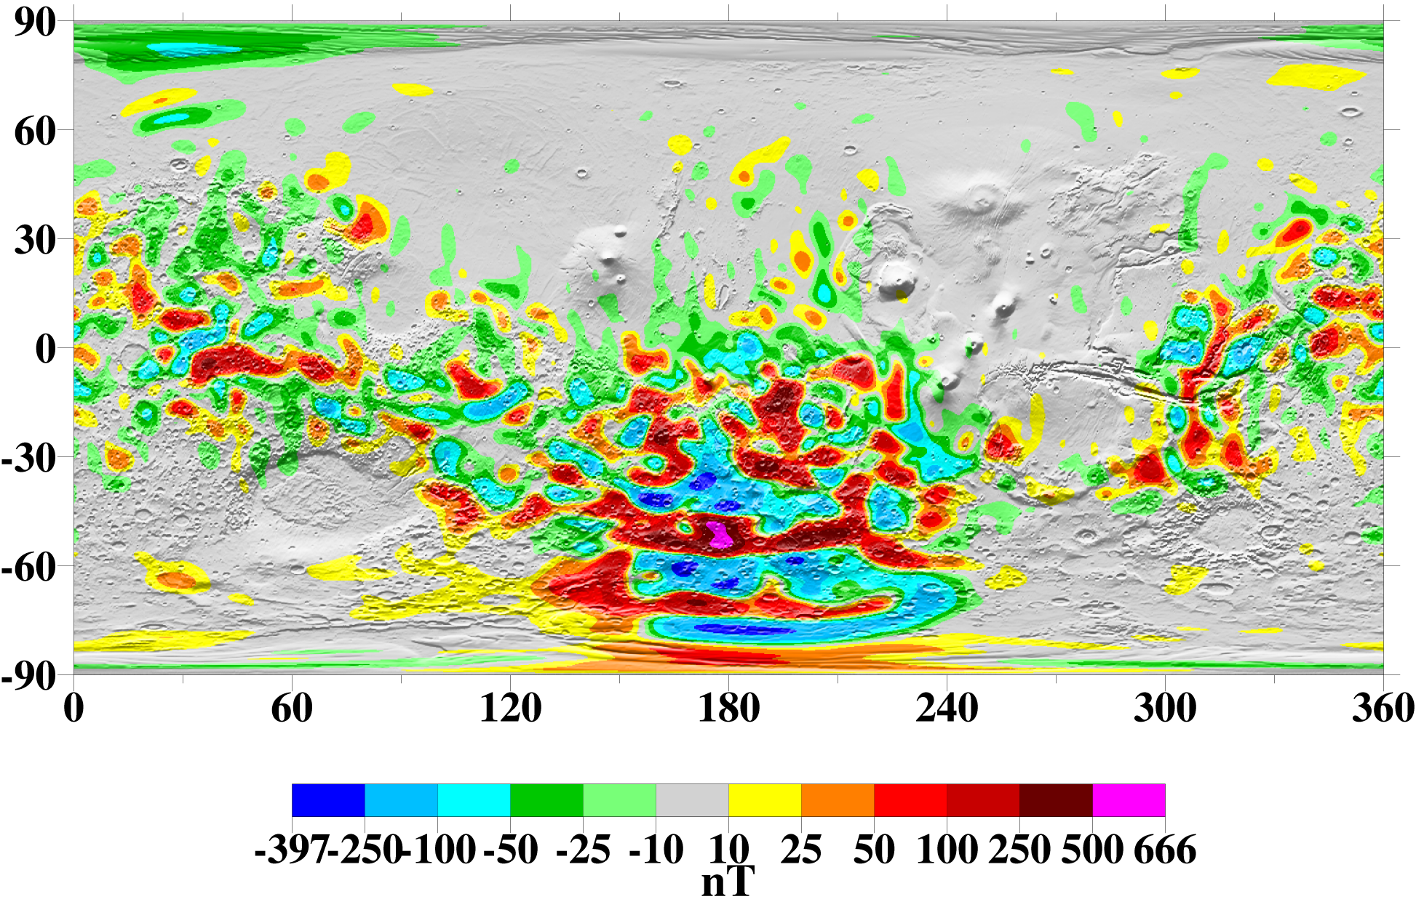
400 km altitude
1000 km altitude
200 km altitude
100 km altitude

Slide 19
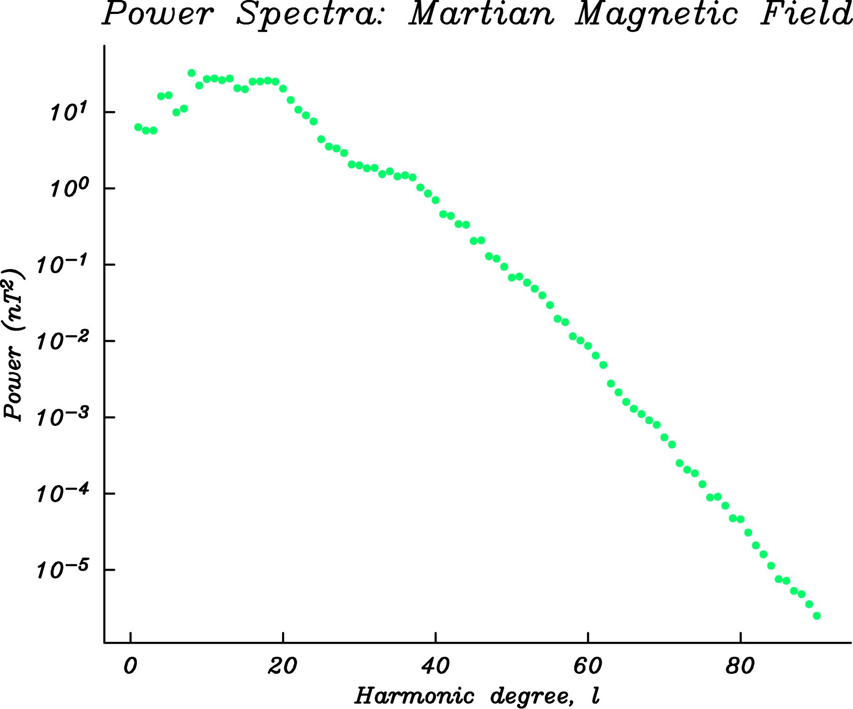
400 km altitude
Spherical harmonic power spectrum:
Analagous to fourier amplitude spectrum:
Fourier transform on z=z₀

Slide 20
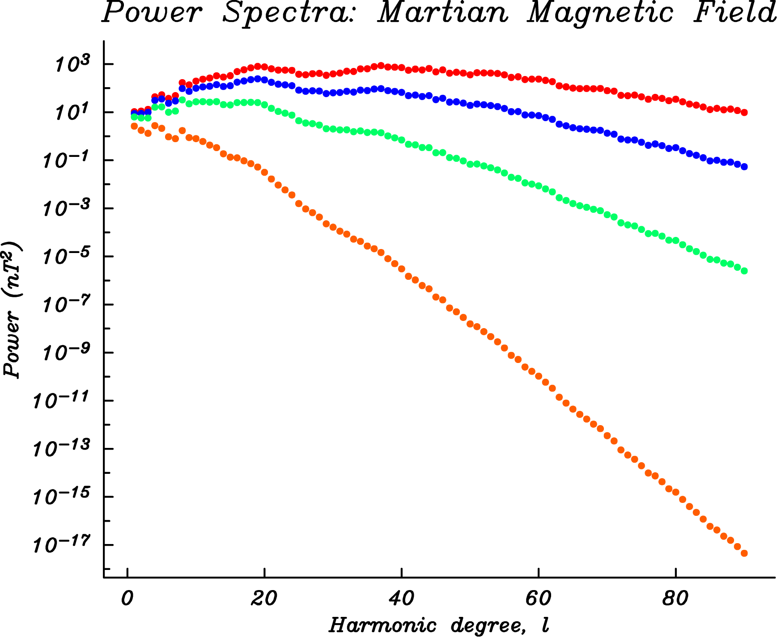
100 km
200 km
400 km
1000 km

Slide 21
400 km altitude
1000 km altitude
200 km altitude
100 km altitude

